Slide 1

Sales Analysis For Tesco
By
Dasi Dinesh
(189539)

Slide 2
Requirement :
To develop a data model in SAP BW/BO to analyze sales for Tesco based on parameters like customer, outlet, sales region, Sales Document, Sales Organization, Sales representative, Sales Group and Material.

Slide 3
Master Data Attributes :
Customer ID
Customer Location
Customer Name
Material Group
Material Name
Material ID
Outlet
Sales Region
Sales Representative
Sales Office

Slide 4
Key Figures :
Price
Quantity
Sales Revenue
Tax
Amount

Slide 5
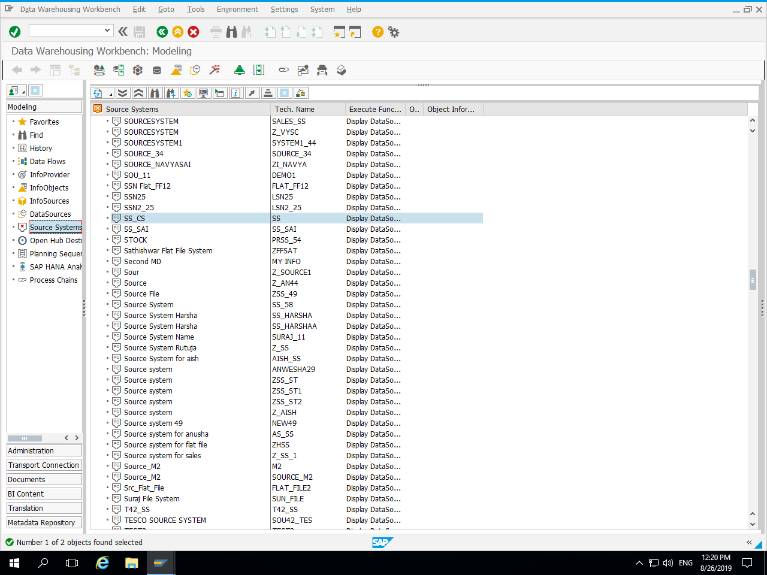
Source System :

Slide 6
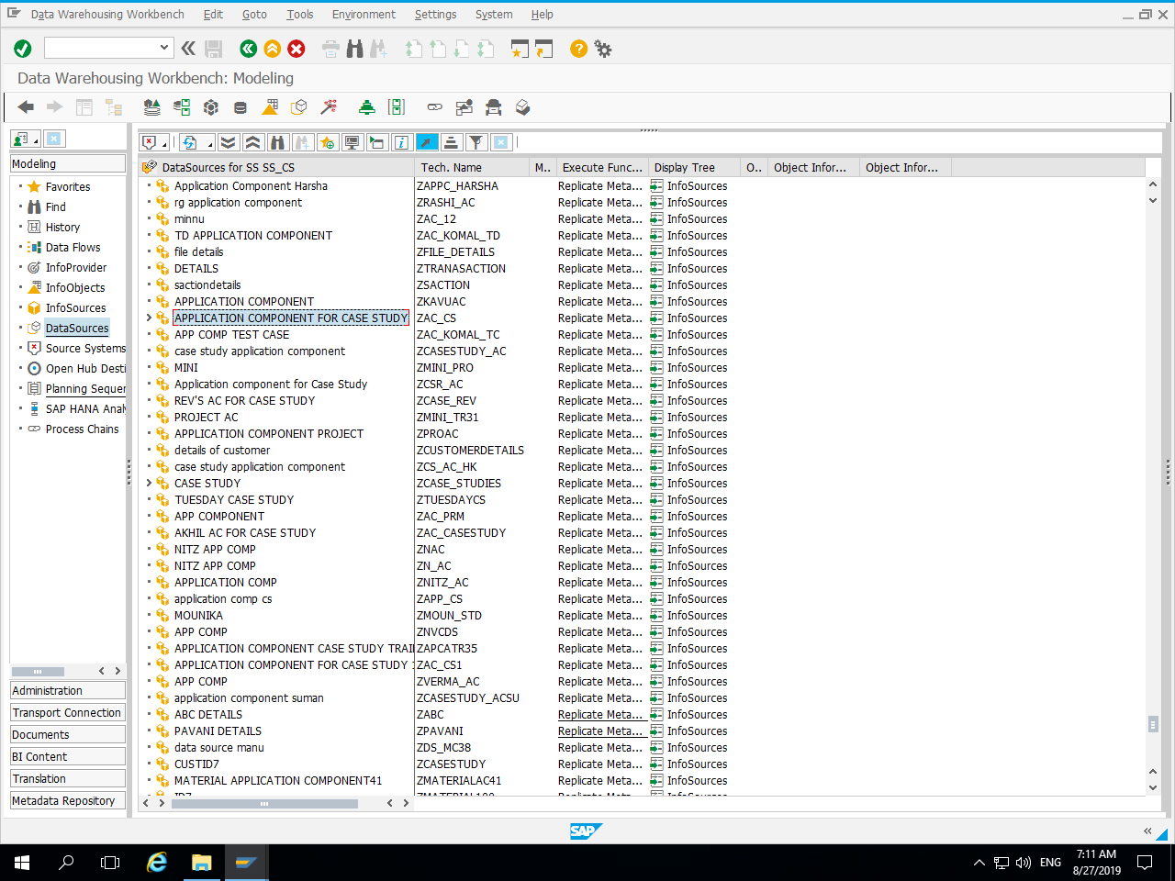
Application Component :

Slide 7
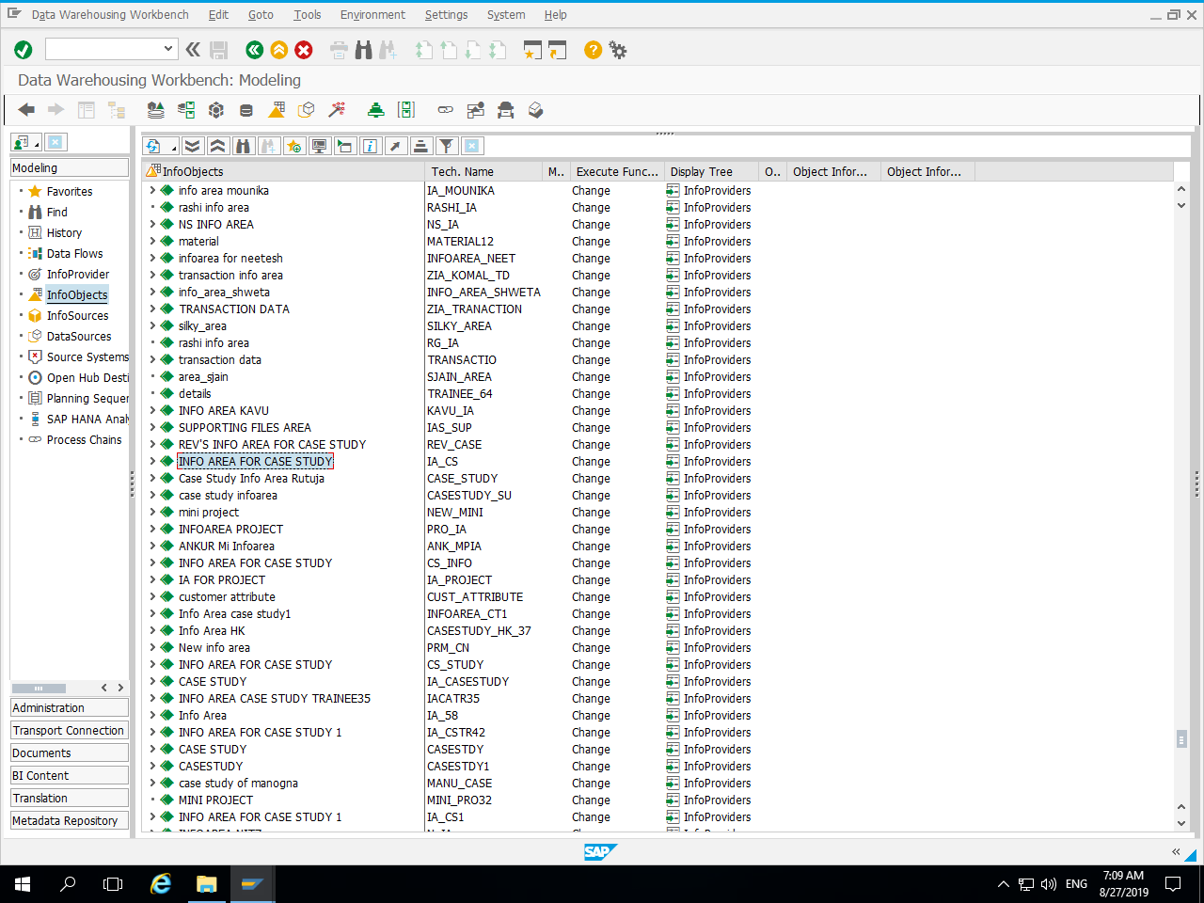
Info Area :

Slide 8
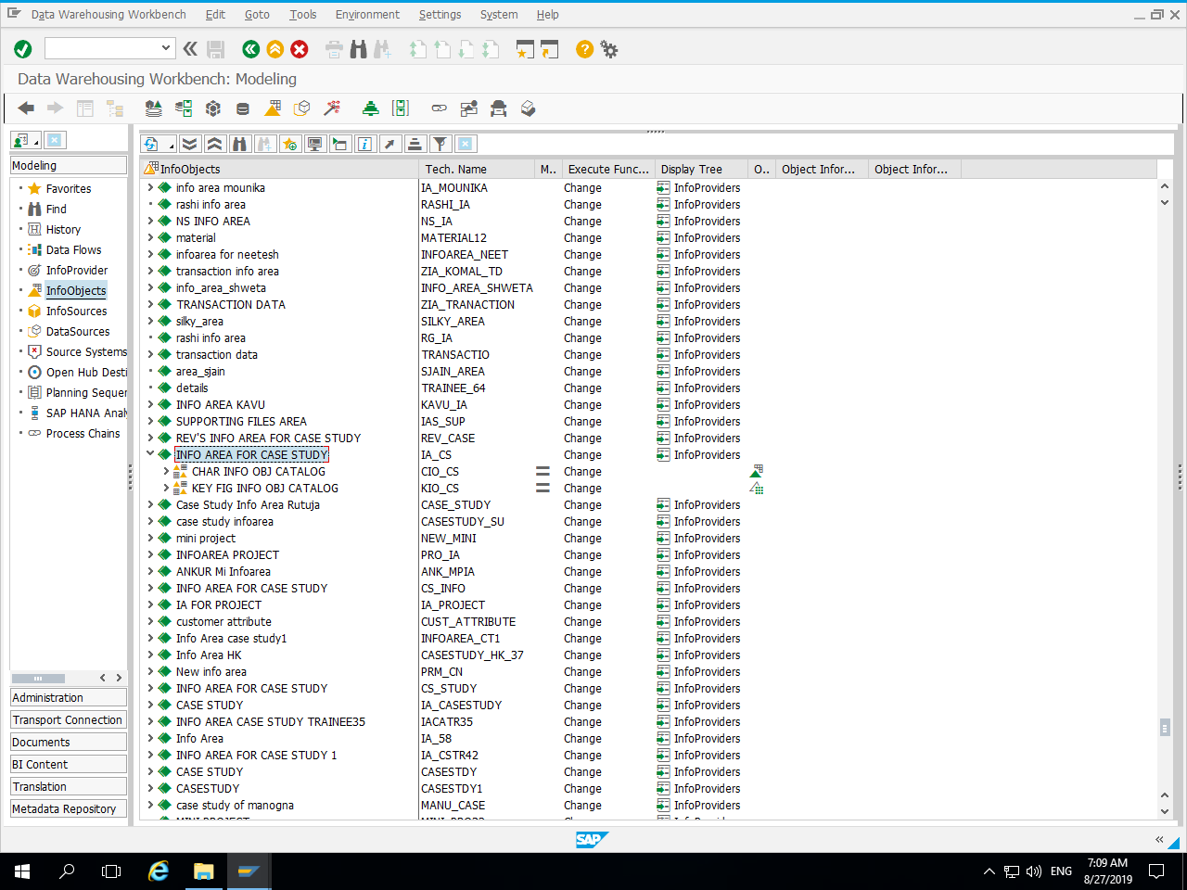
Info Area With Catalogs :

Slide 9
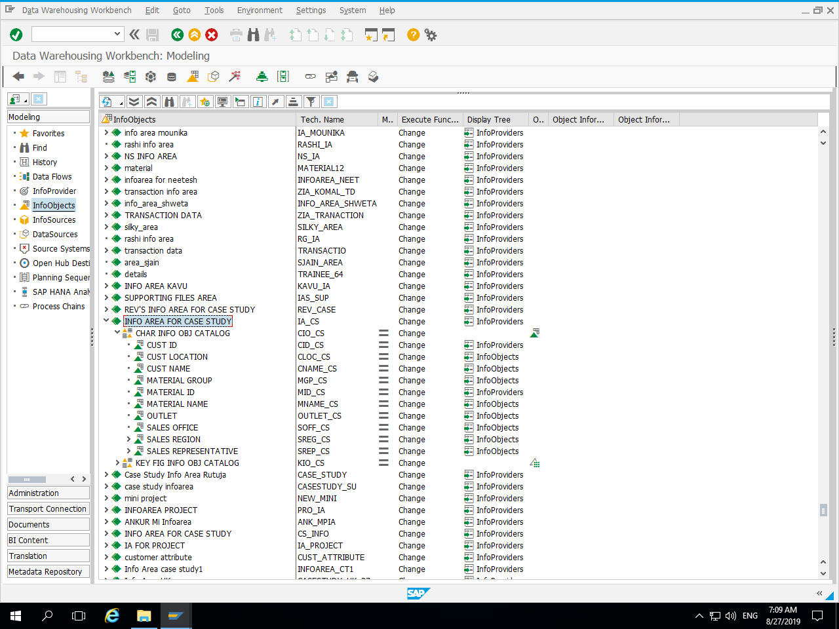
Characteristic Info Object Catalog with Characteristic Info Objects :

Slide 10
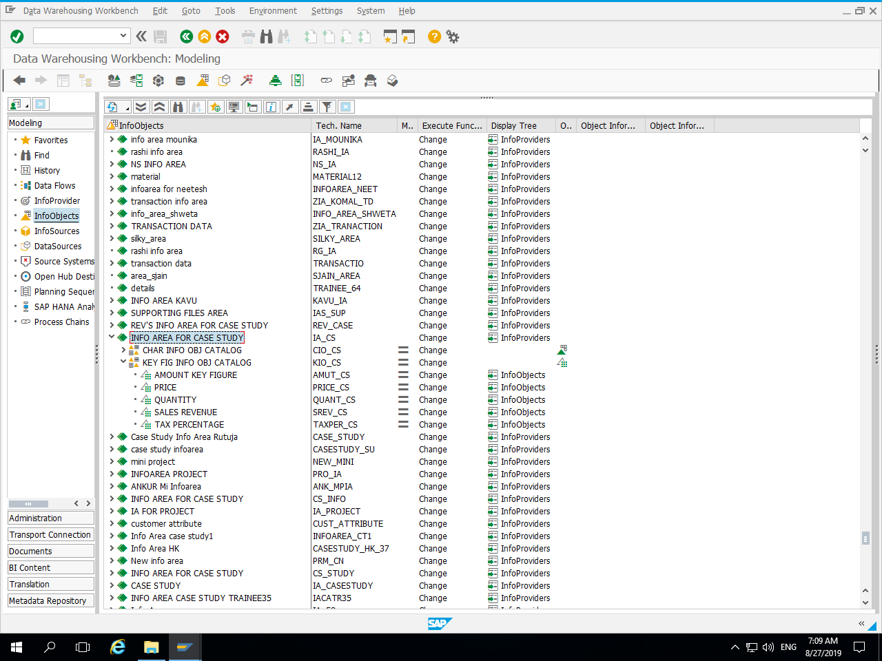
Key Figure Info Object Catalog with Key Figure Info Objects :

Slide 11
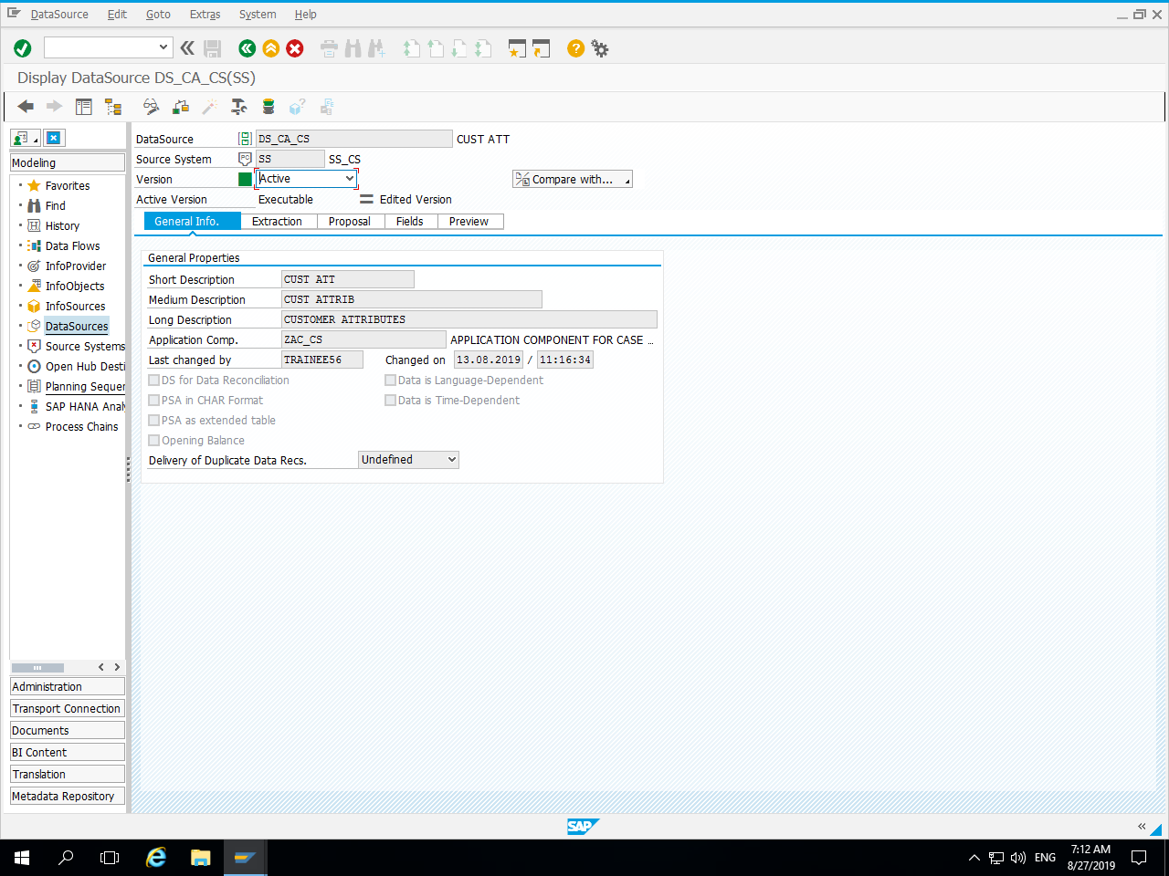
Data Source :

Slide 12
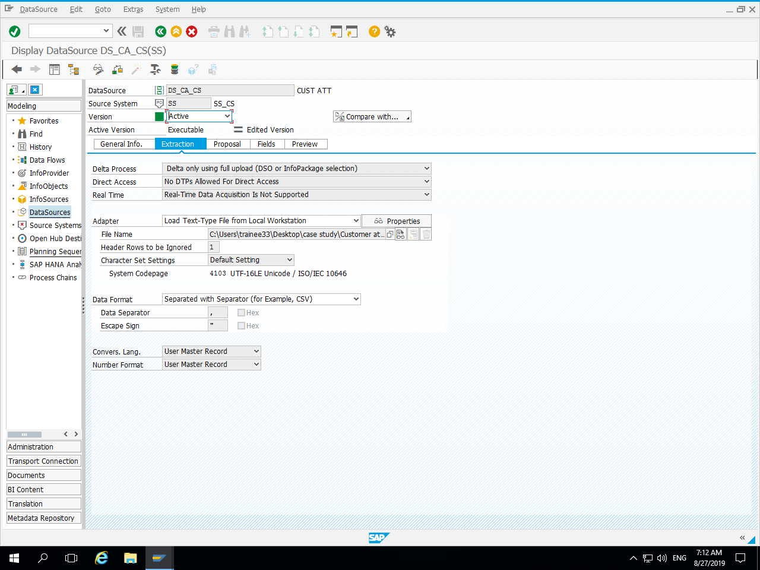
Extraction :

Slide 13
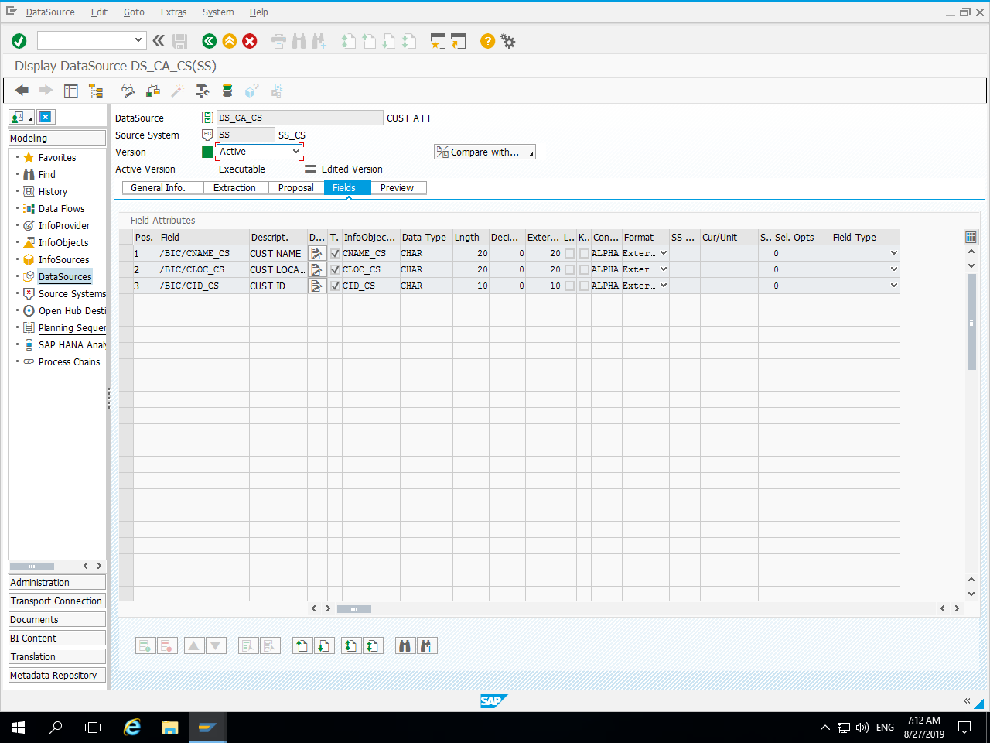
Fields :

Slide 14
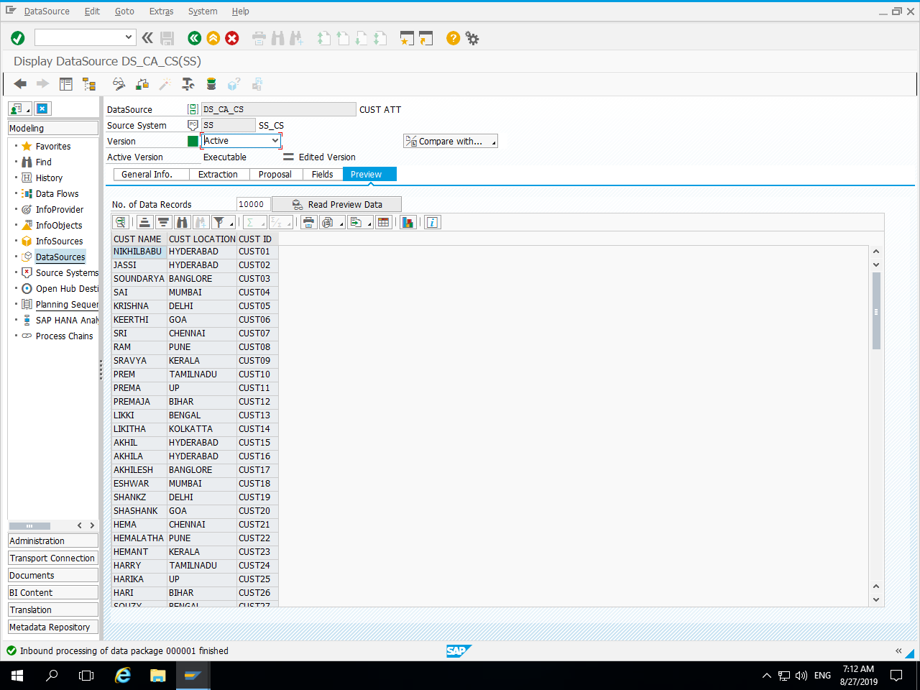
Data Preview in Data Source :

Slide 15
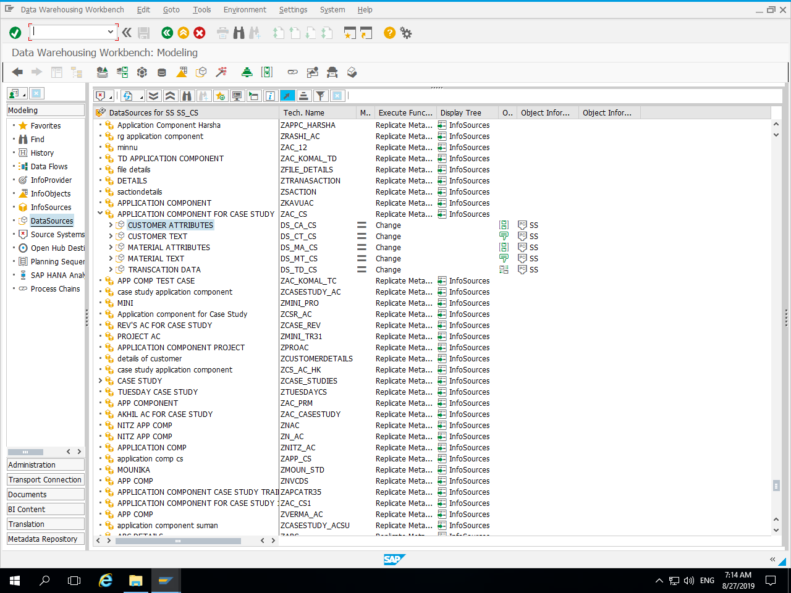
Data Sources in Application Component :

Slide 16
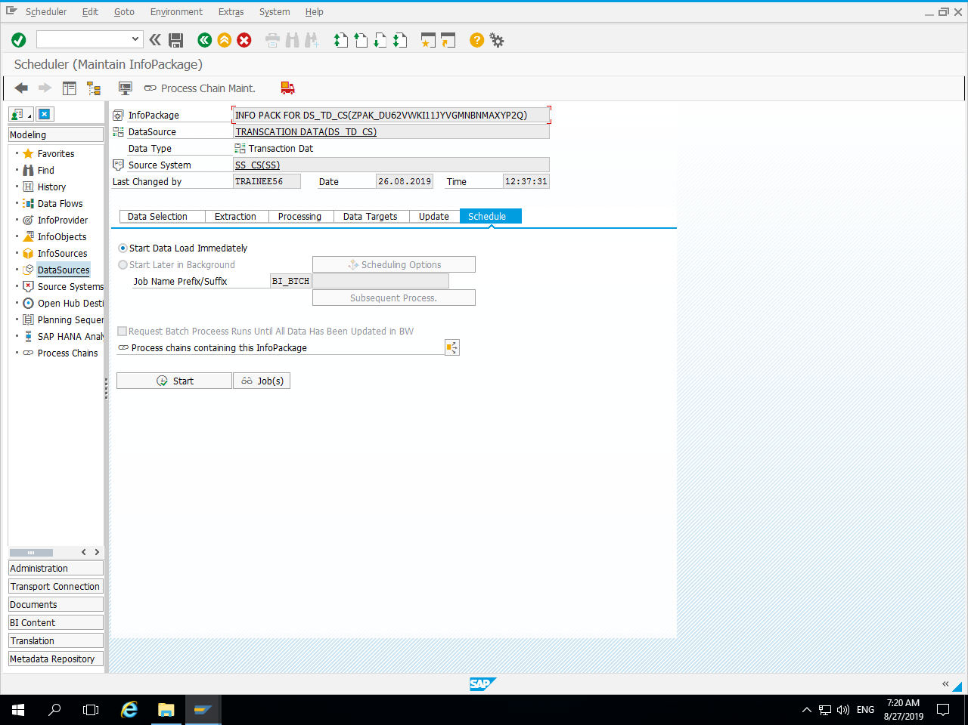
Info Package Scheduling :

Slide 17
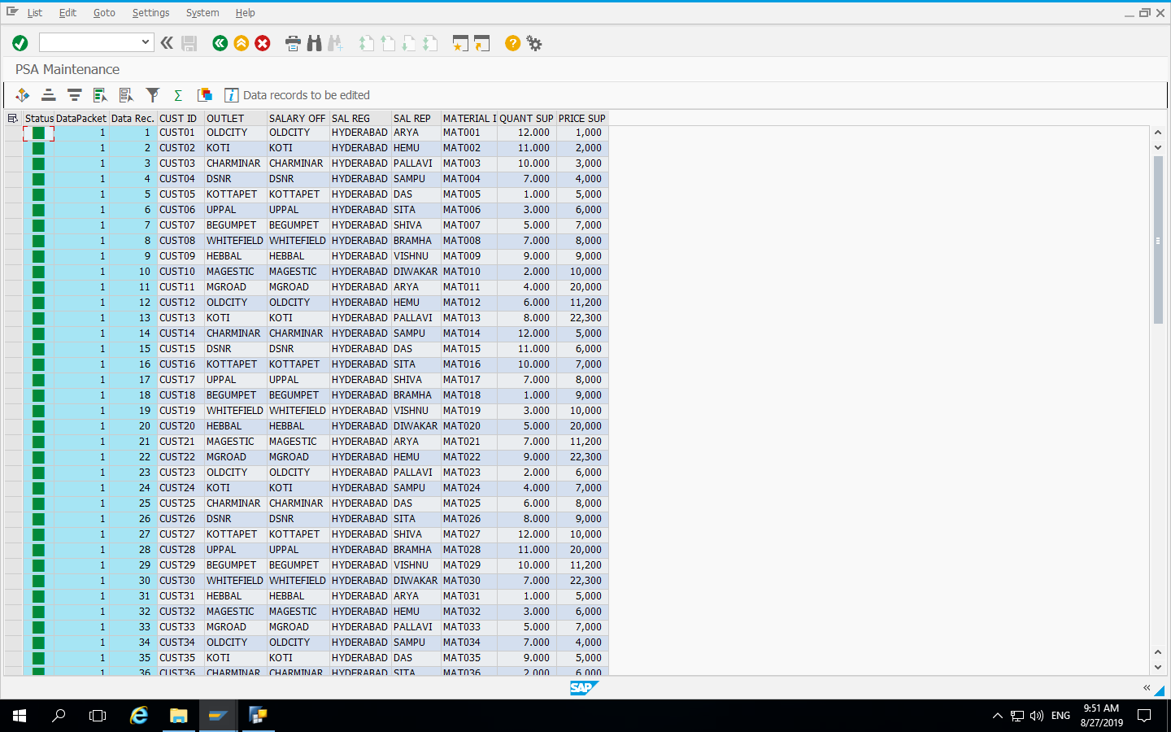
Data in PSA :

Slide 18
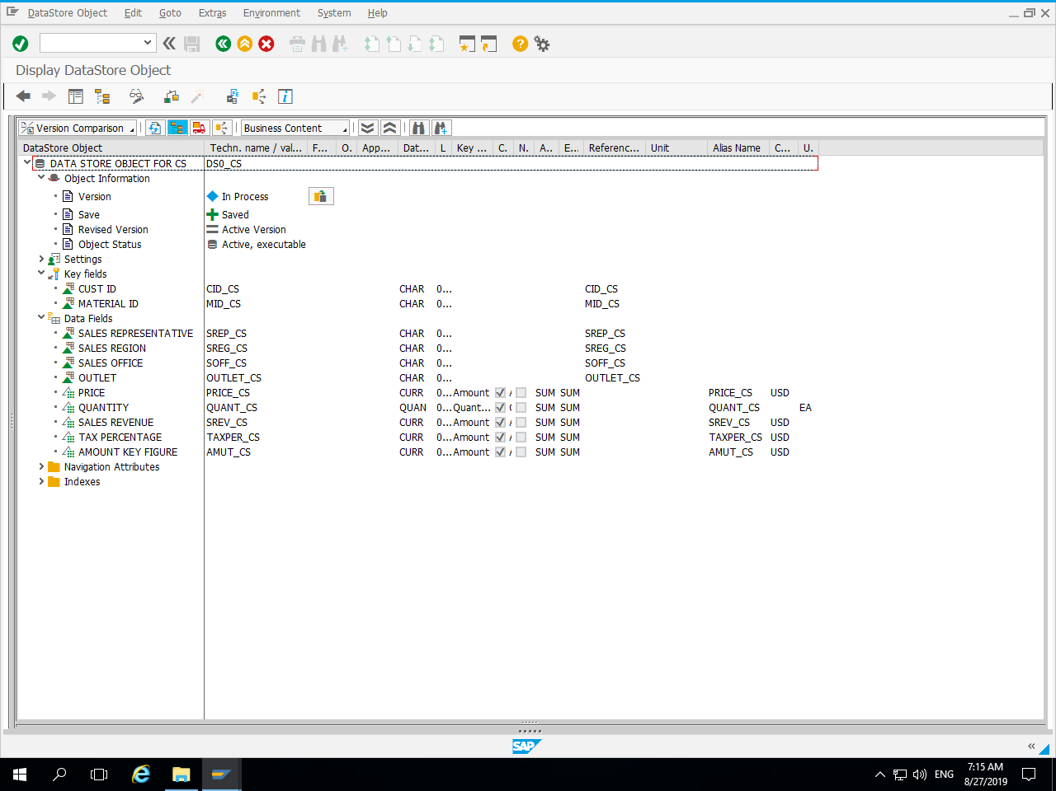
Data Store Object with Key Fileds and Data Fileds :

Slide 19
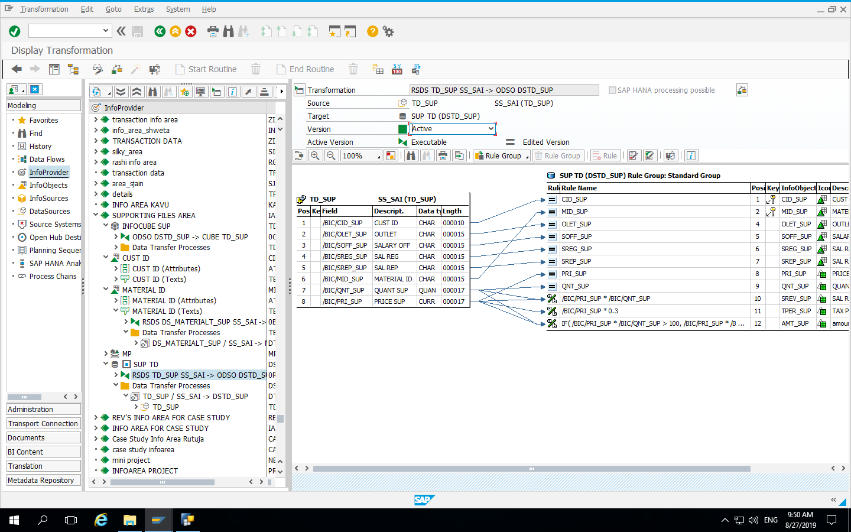
Transformation between Data Source and DSO :

Slide 20
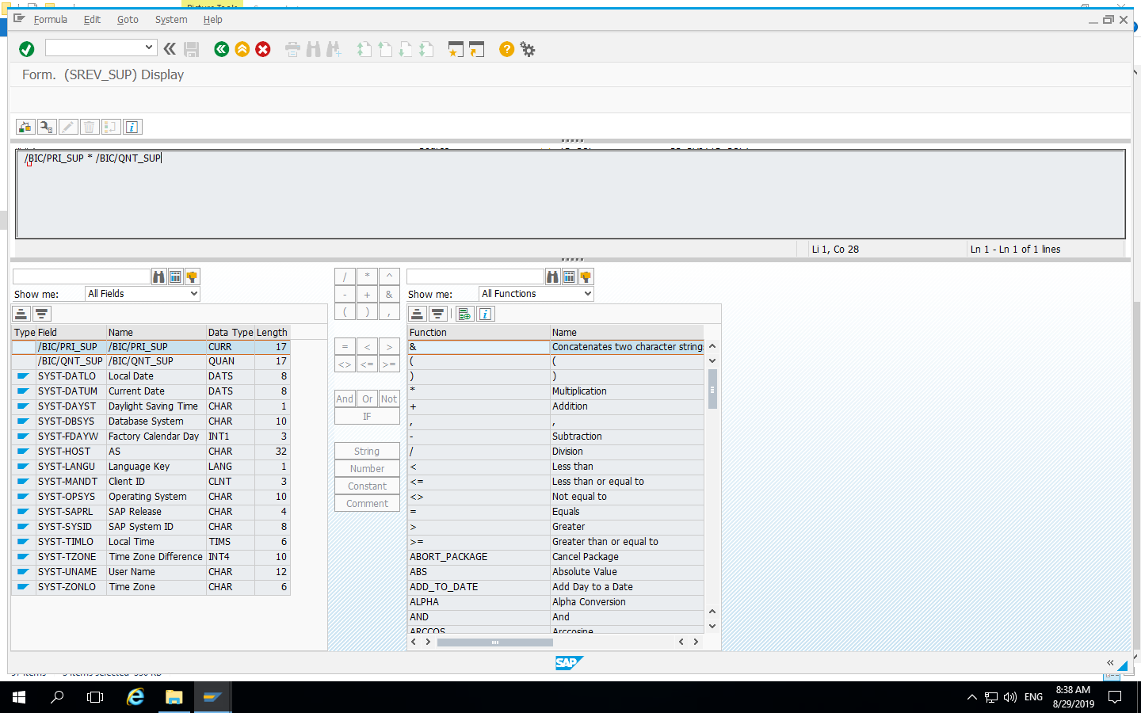
Formula for Sales Revenue = Price * Quantity :

Slide 21
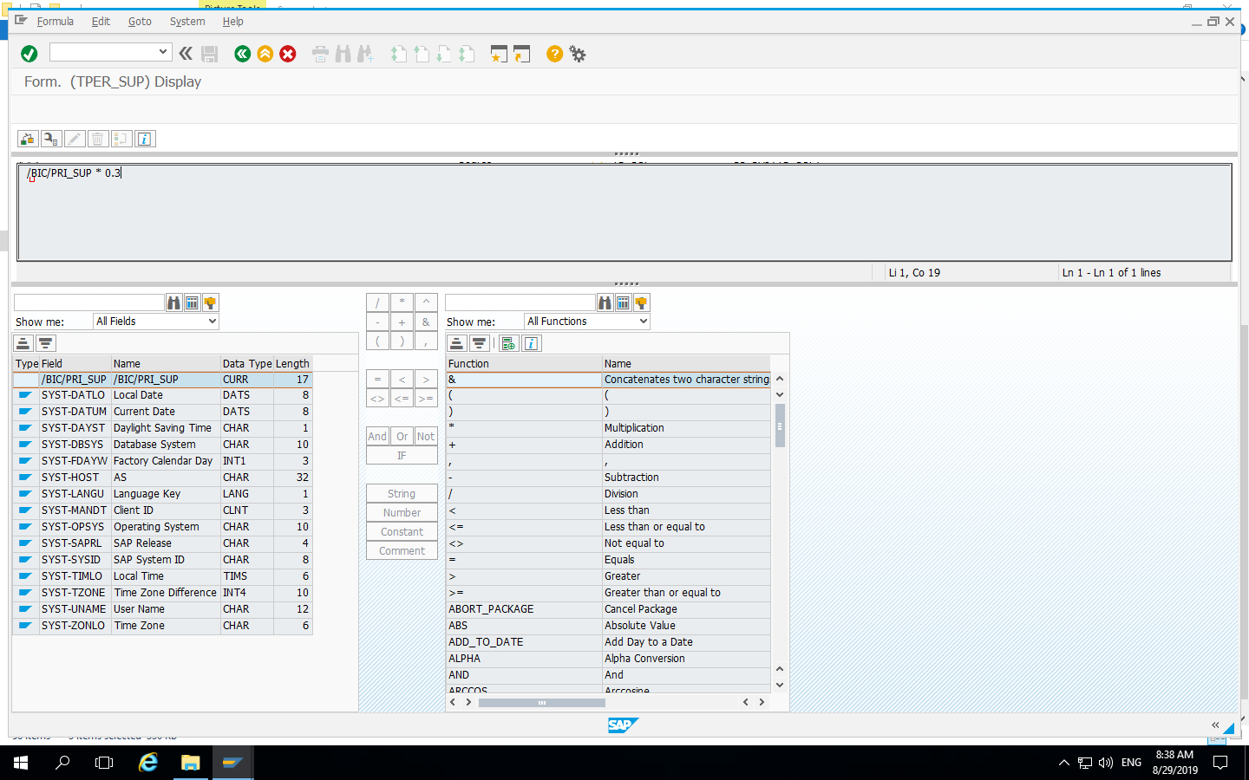
Formula for Tax = Price * 0.3 :

Slide 22
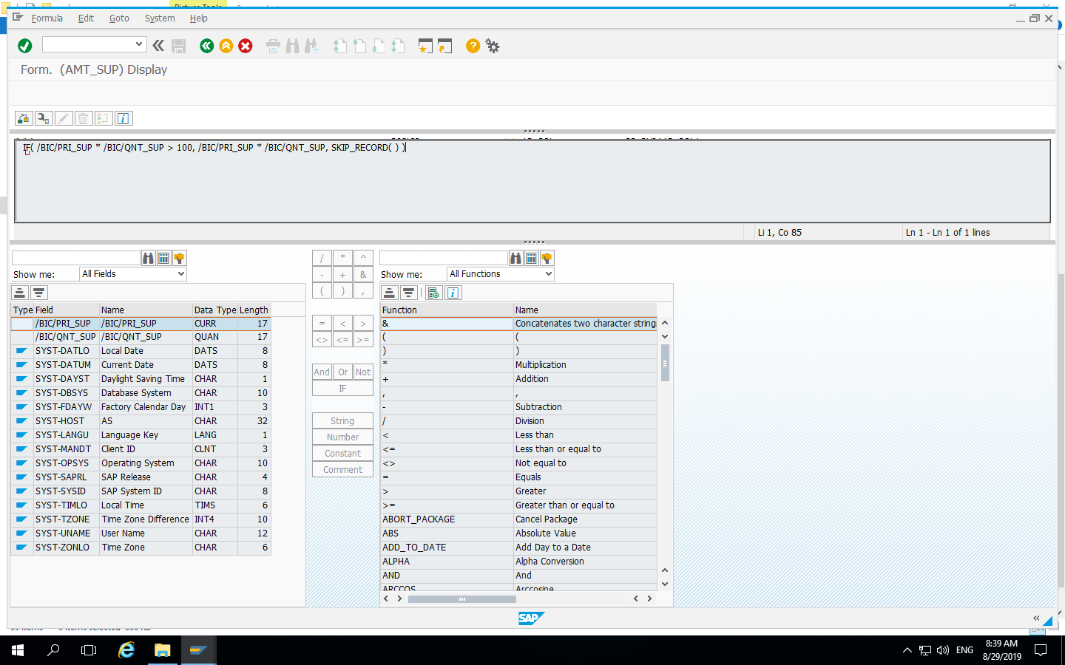
Formula for skipping records using condition :

Slide 23
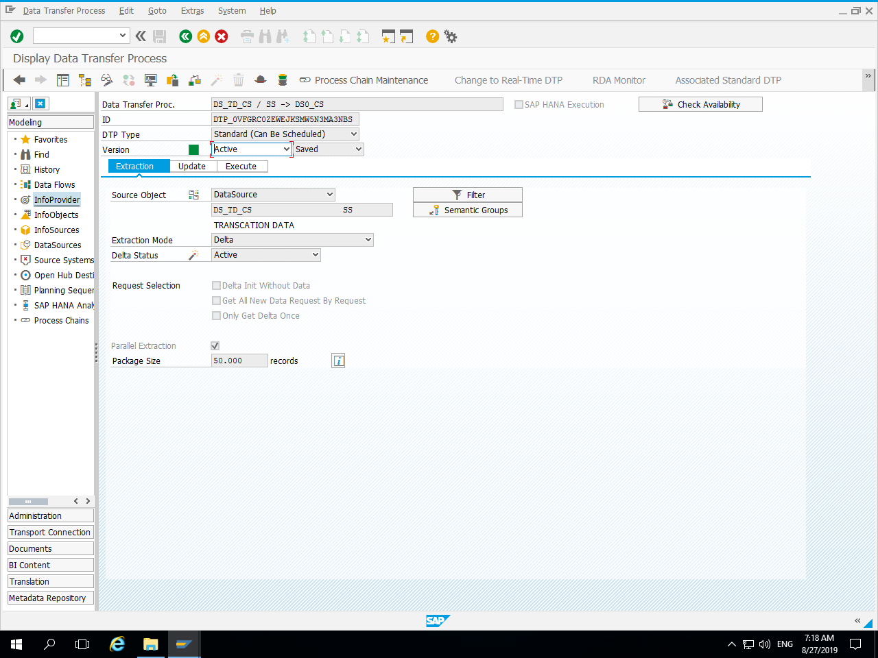
Data Transfer Process from DS → DSO :

Slide 24
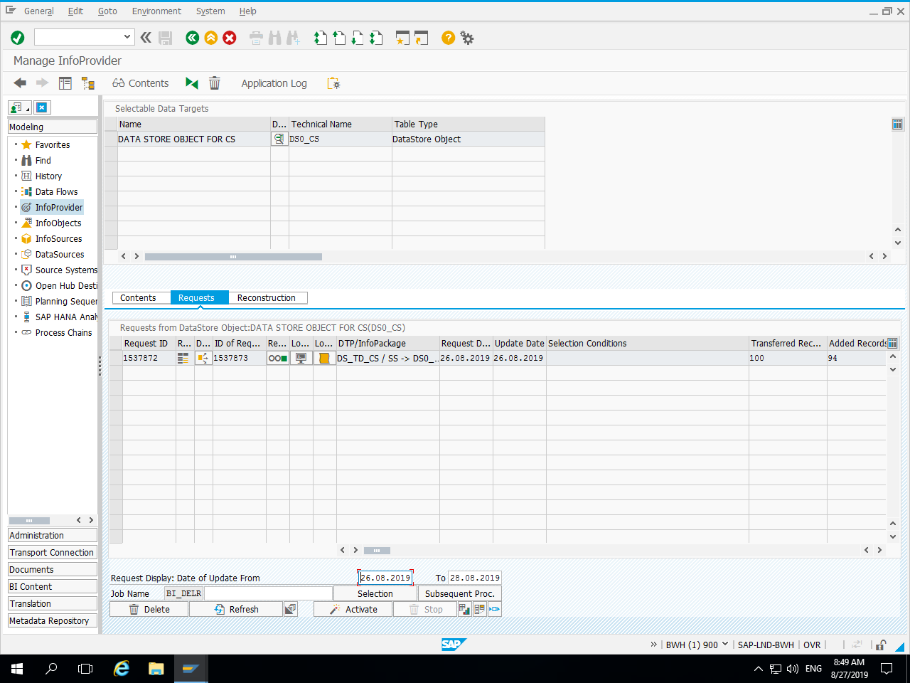
Request in Data Store Object(DSO) :

Slide 25
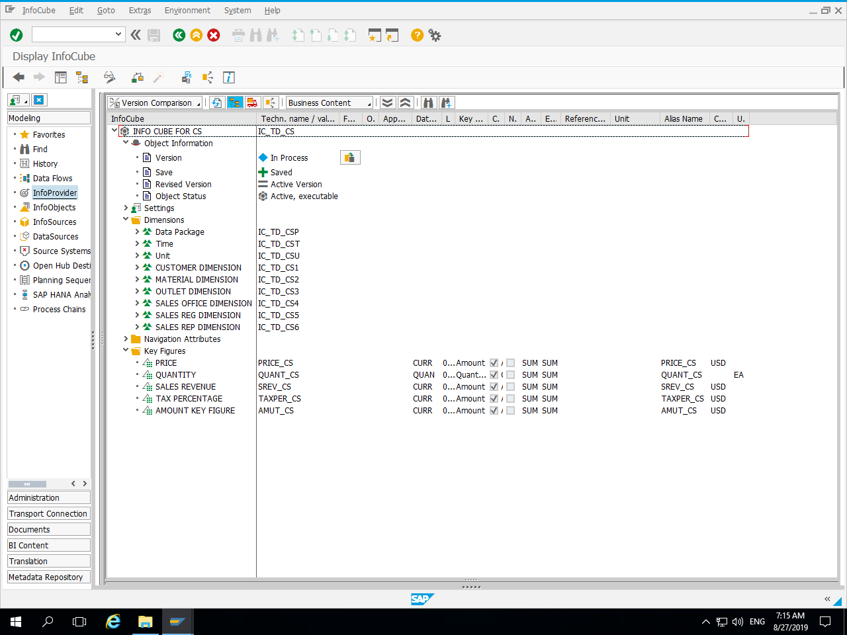
Info Cube with Dimensions and key Figures :

Slide 26
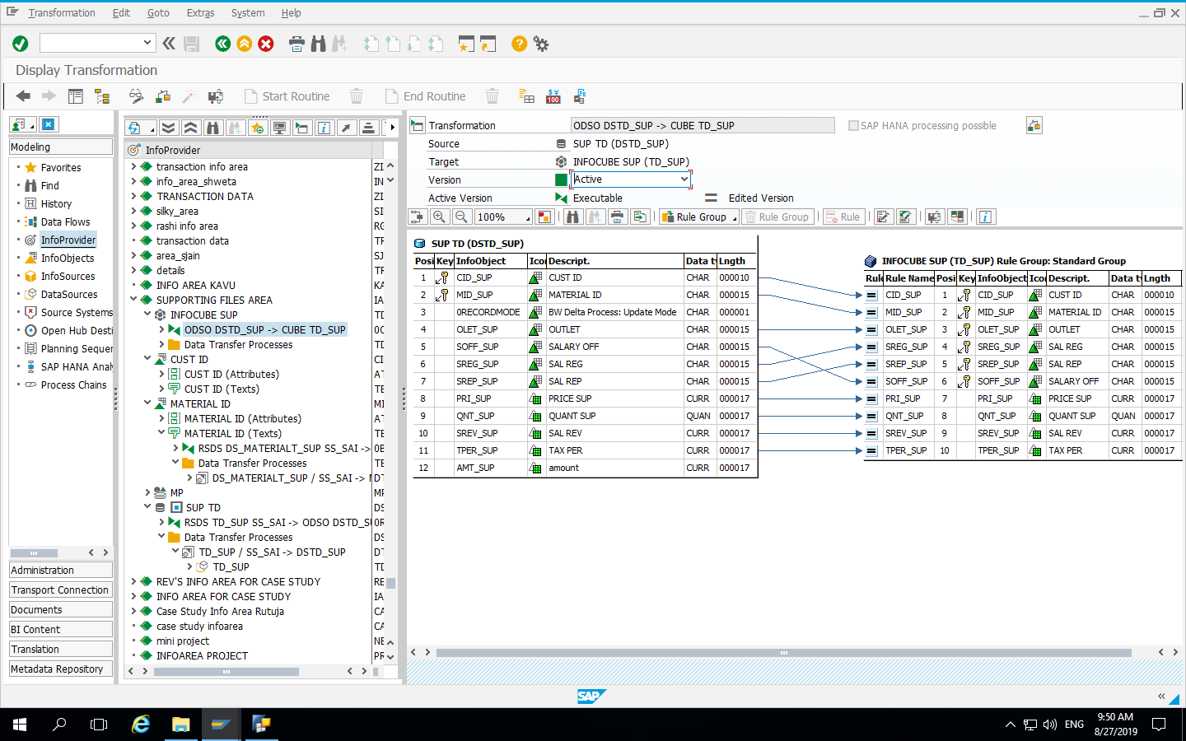
Transformation between DSO and Info Cube :

Slide 27
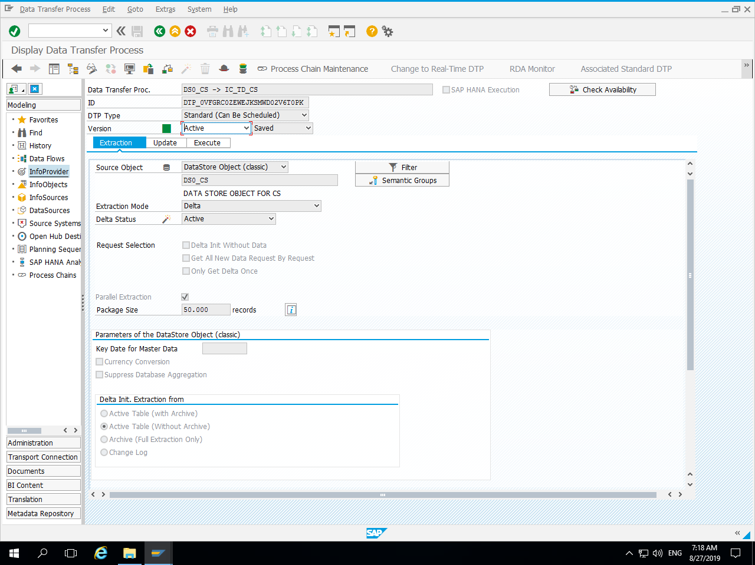
Data Transfer Process from DSO → Info Cube :

Slide 28
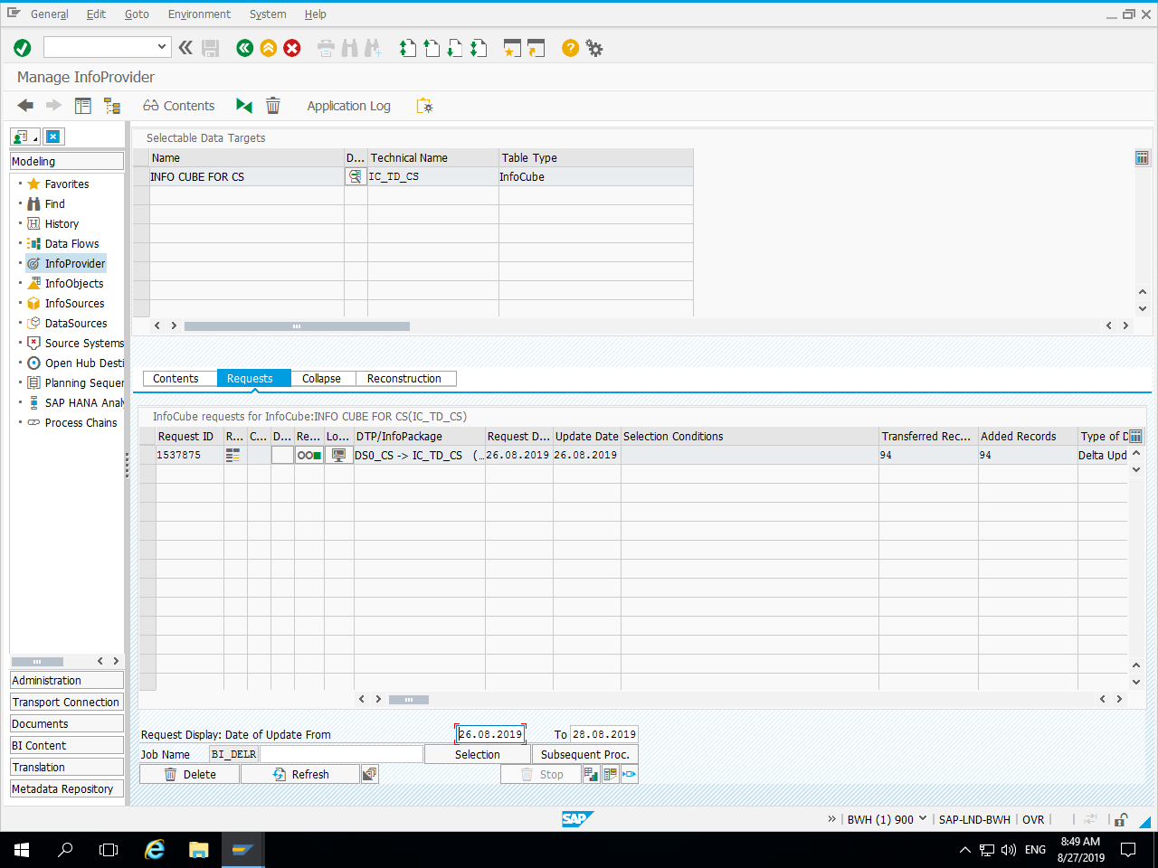
Request in Info Cube :

Slide 29
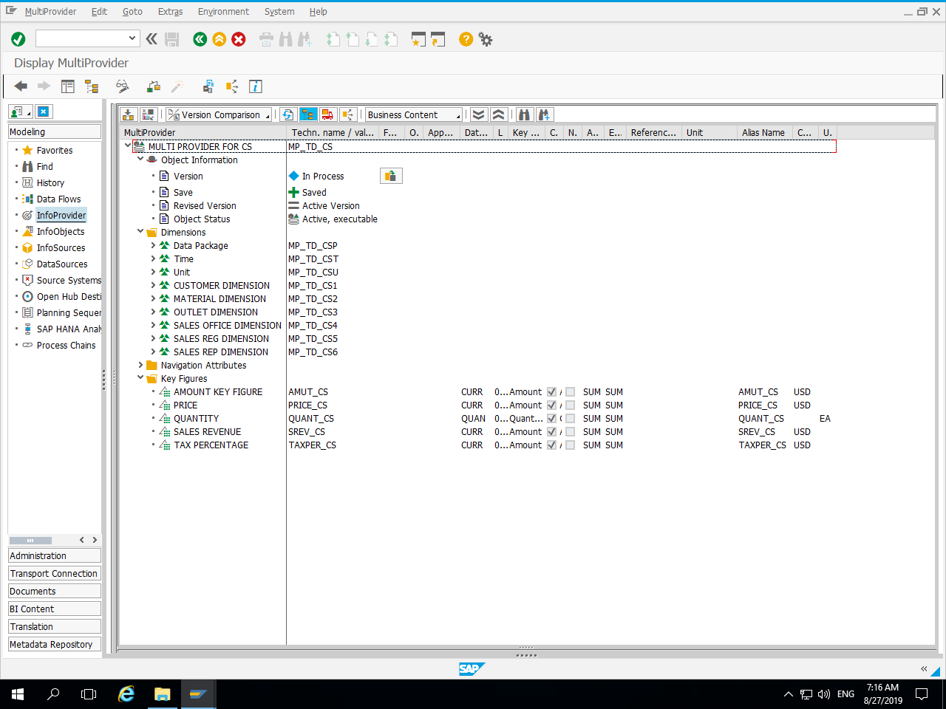
Multi-Provider with Dimensions and Key Figures ;

Slide 30
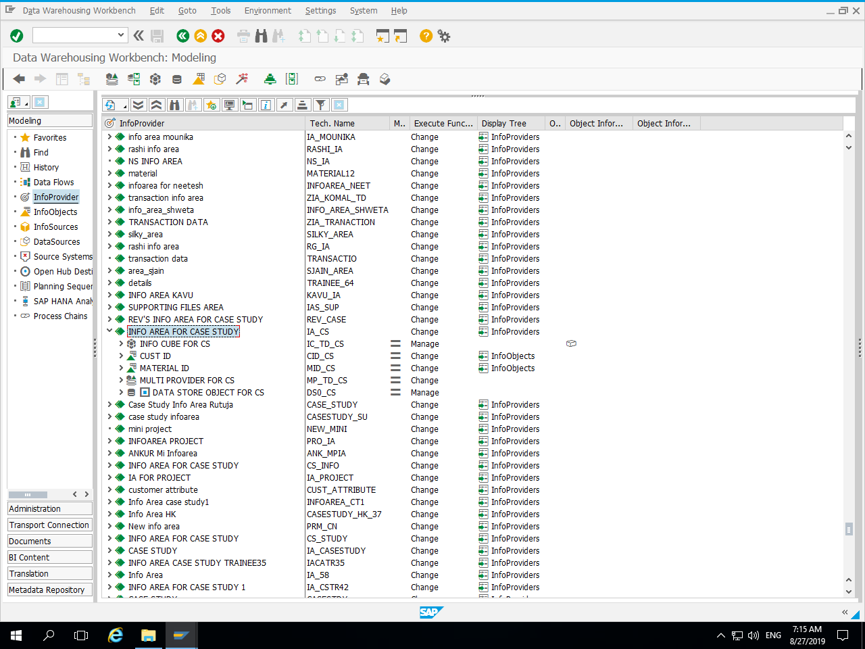
Info Area with Info Providers :

Slide 31
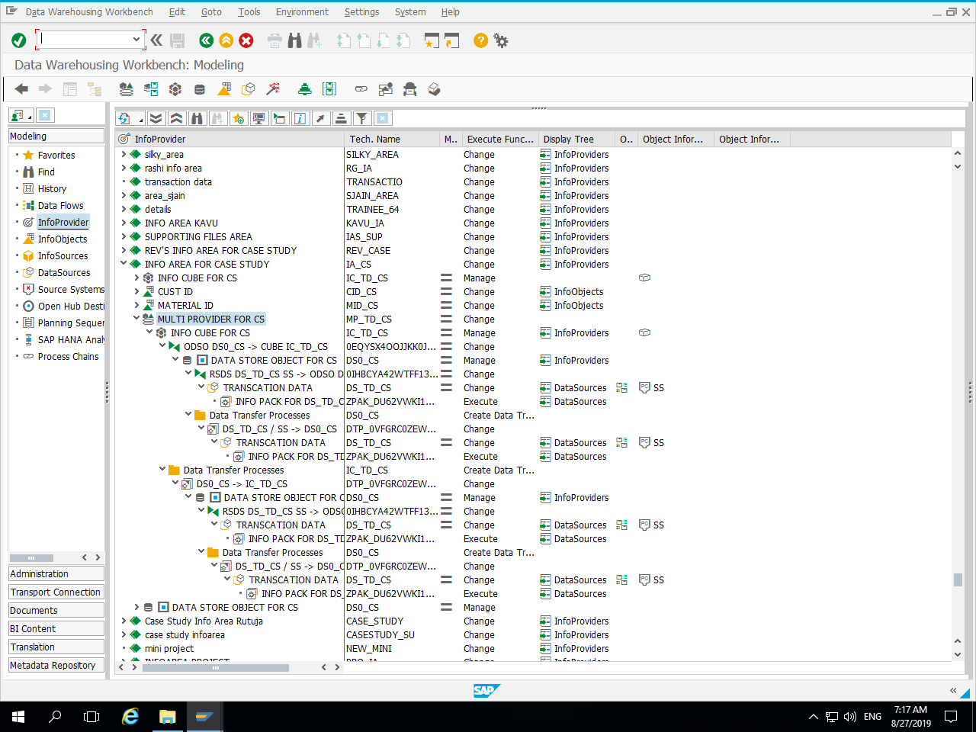
Info Provider with Transformations and Data Transfer Process :

Slide 32
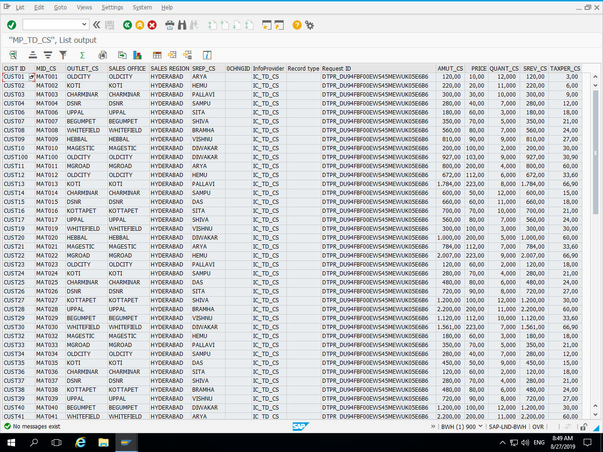
Data in Multi-provider :

Slide 33
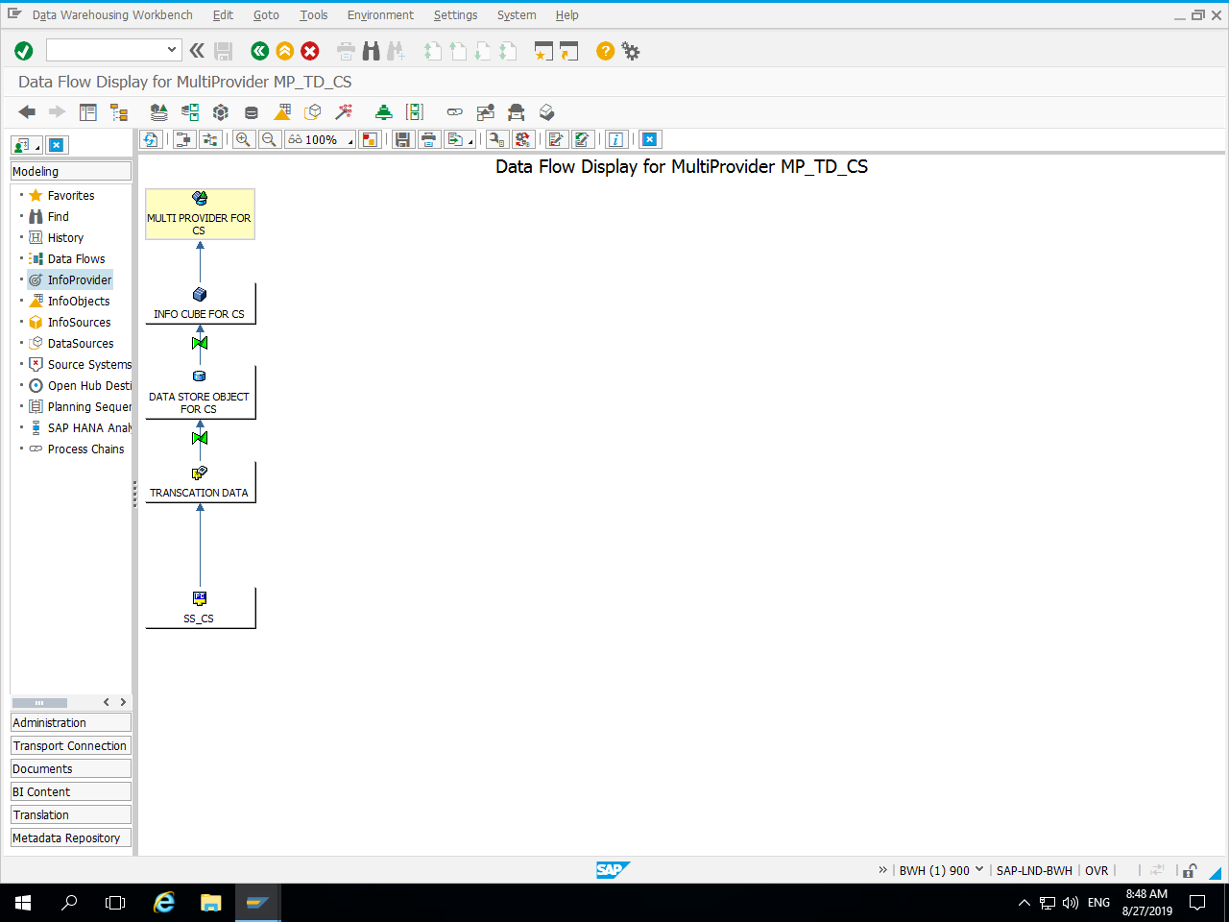
Data Flow :

Slide 34
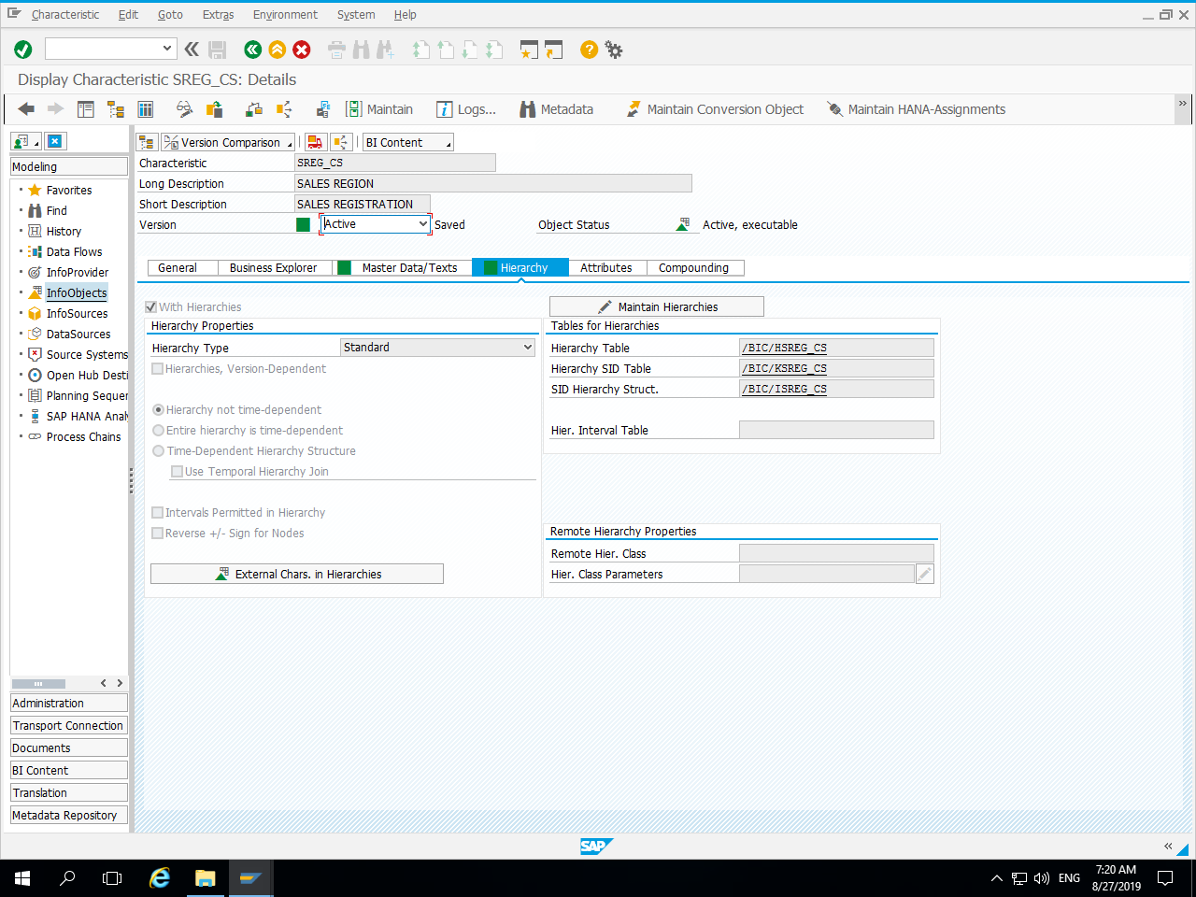
Sales Hierarchy :

Slide 35
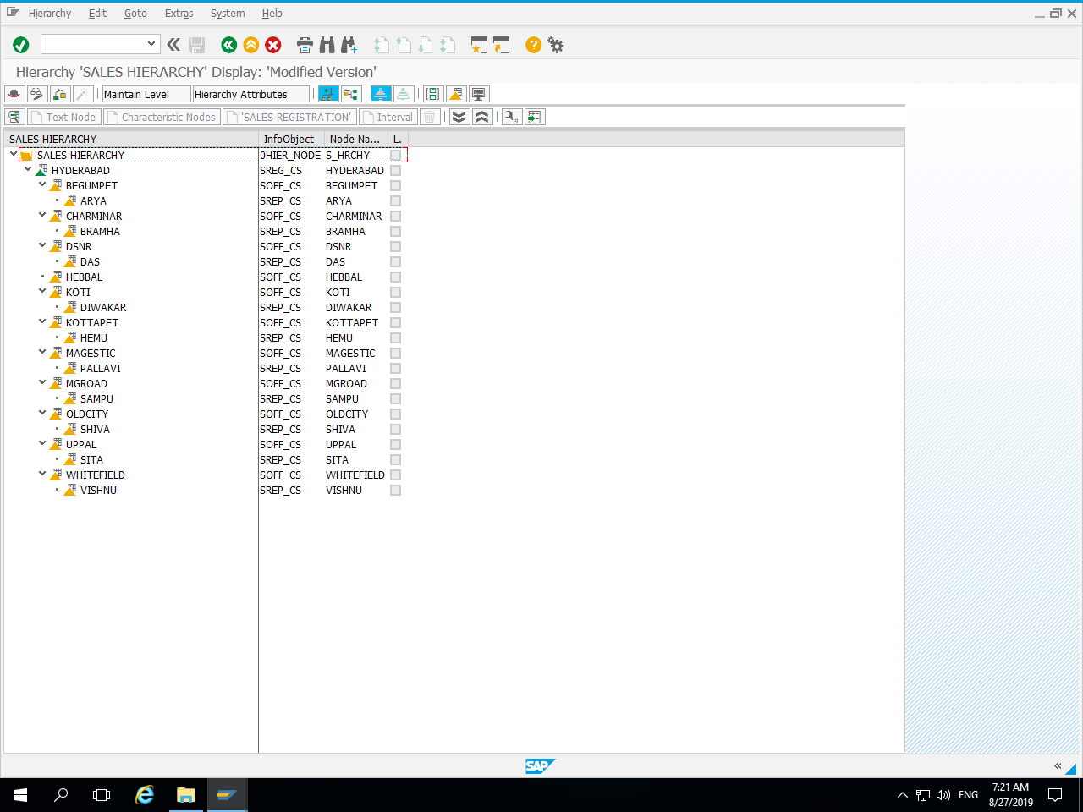
Region → Office → Sales Representative

Slide 36
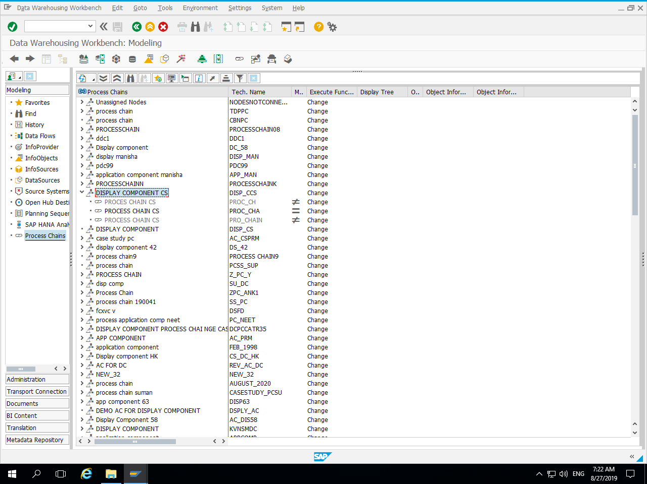
Display Component :

Slide 37
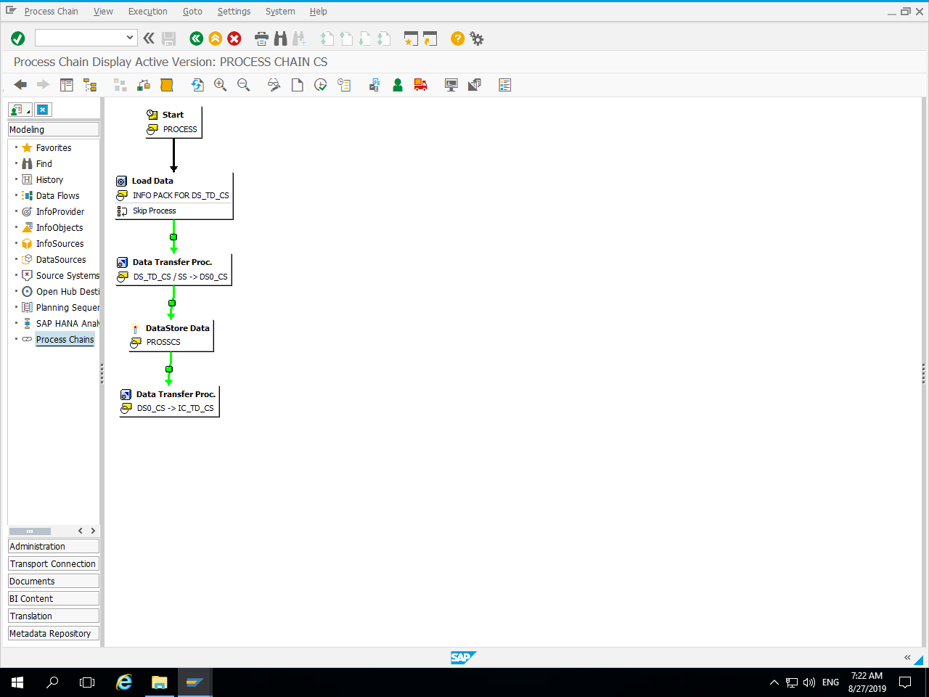
Process Chain :

Slide 38
BEx Reports

Slide 39
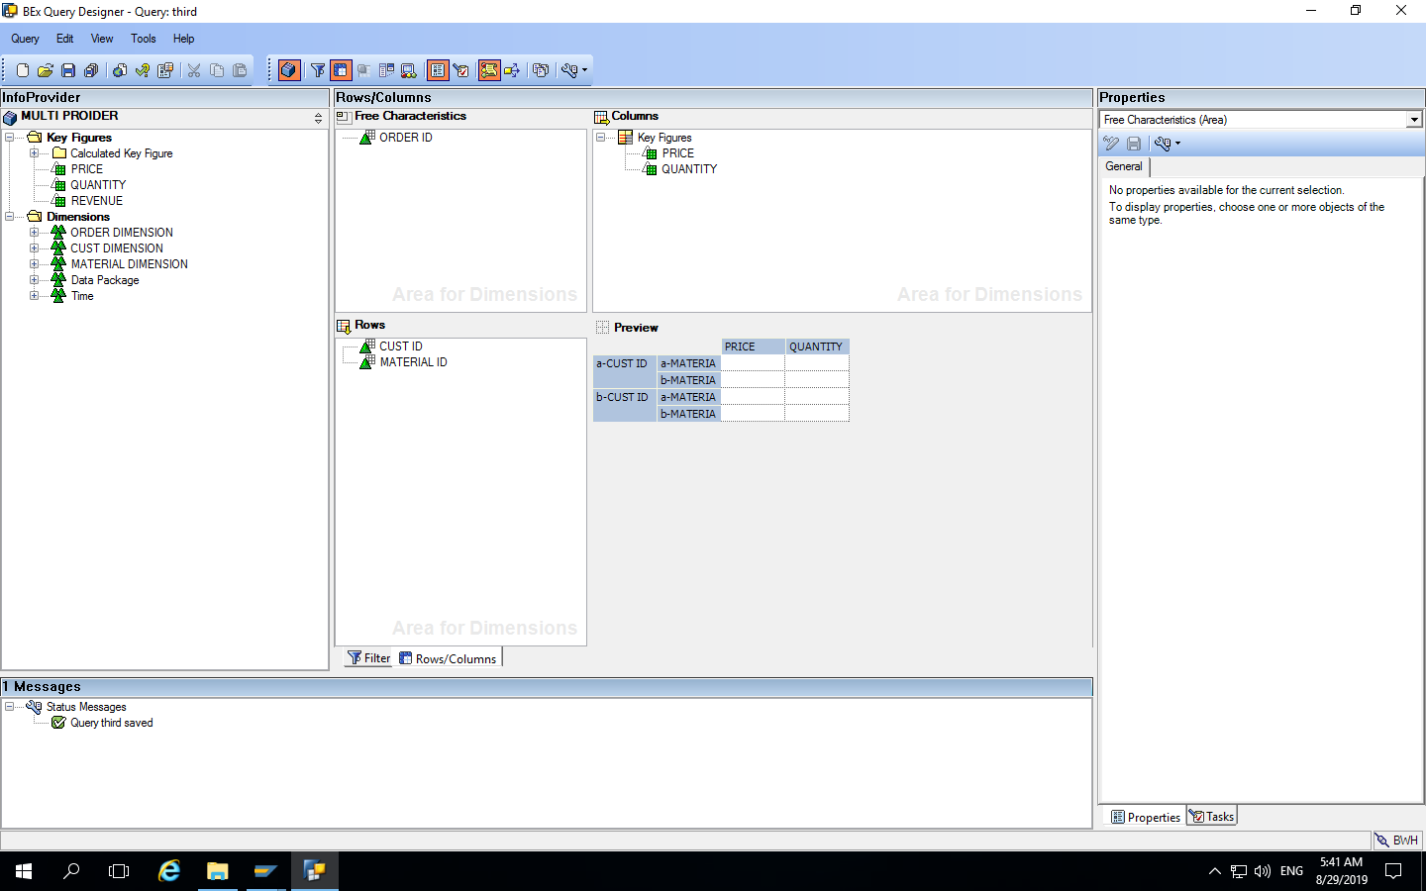
Report 1 :

Slide 40
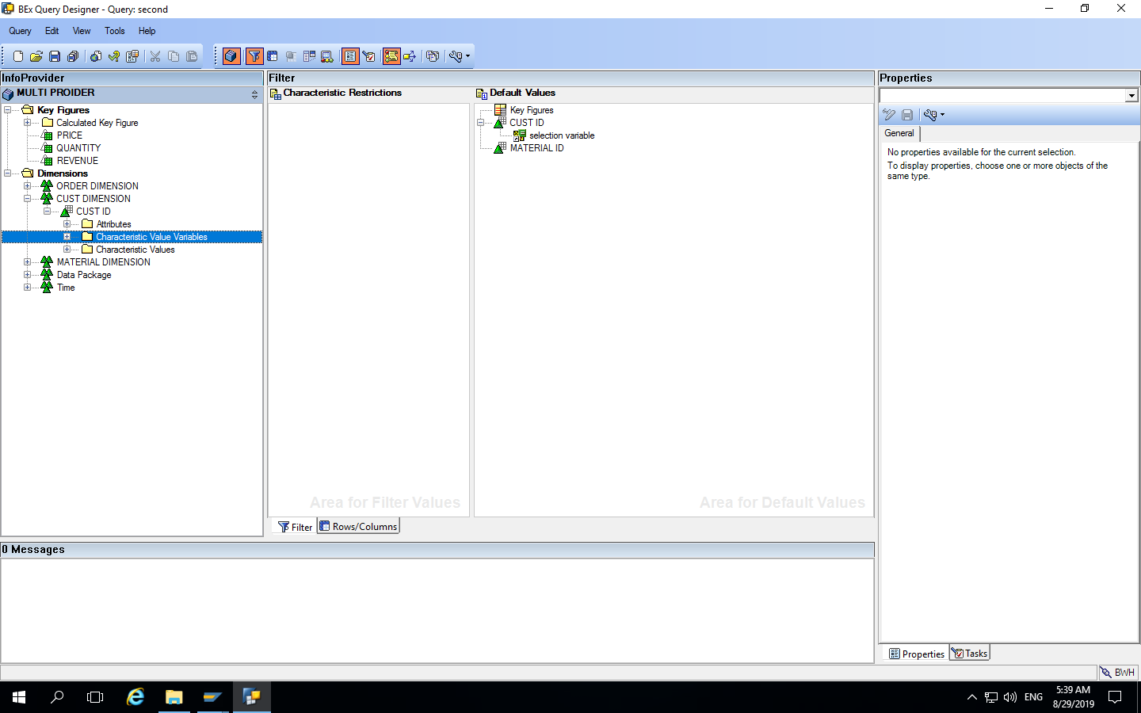
Using Variables :

Slide 41
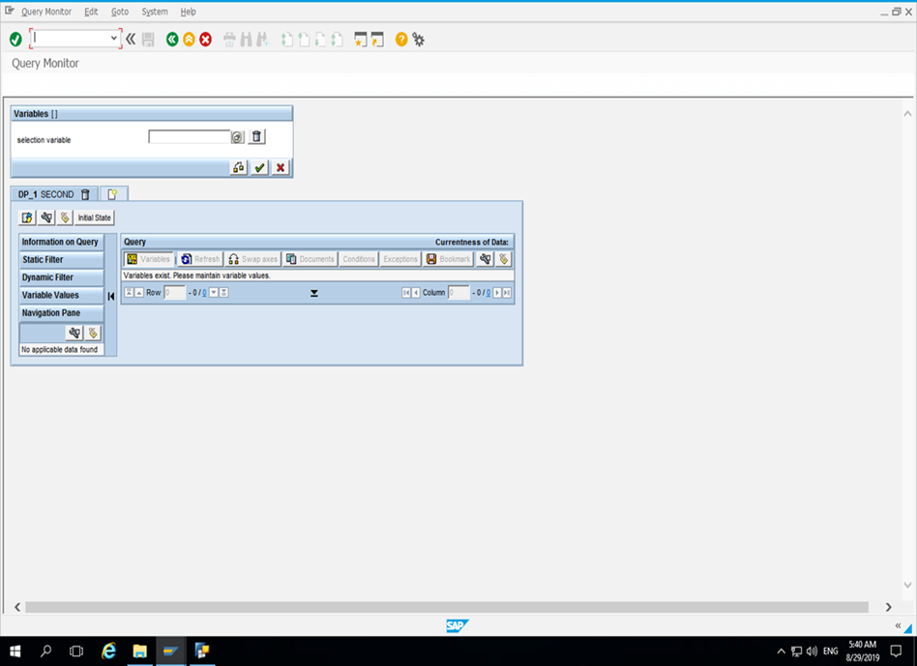

Slide 42
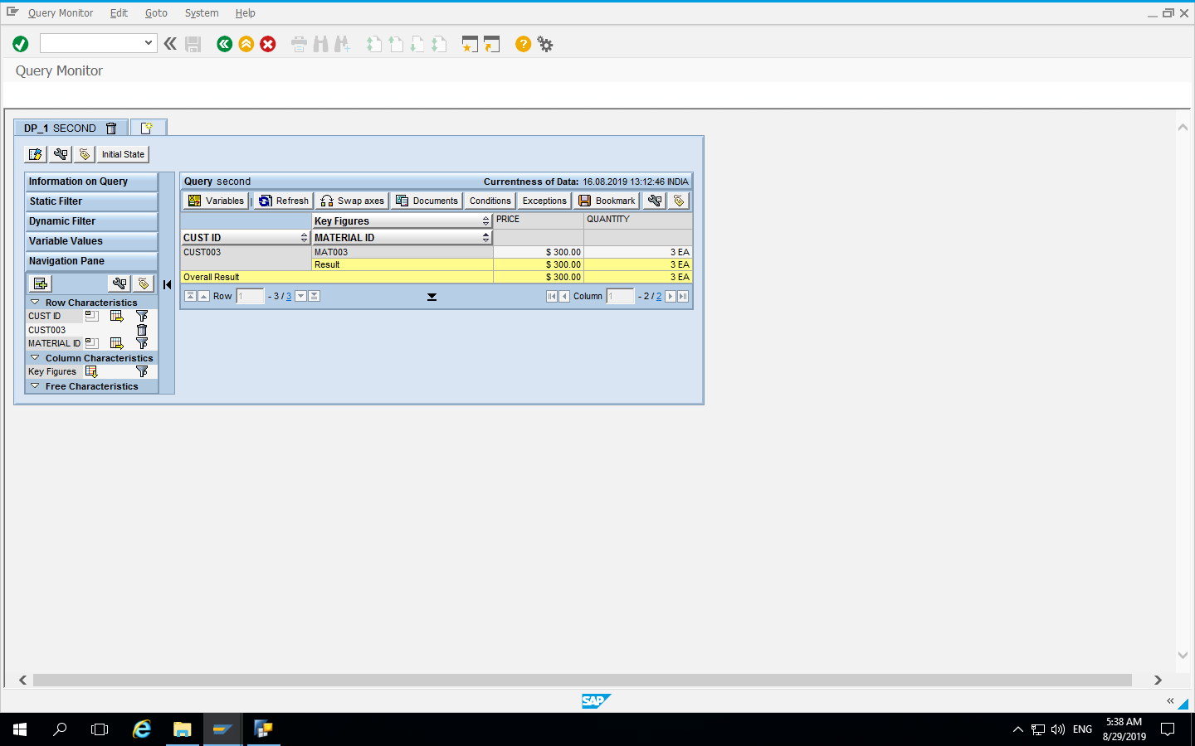

Slide 43
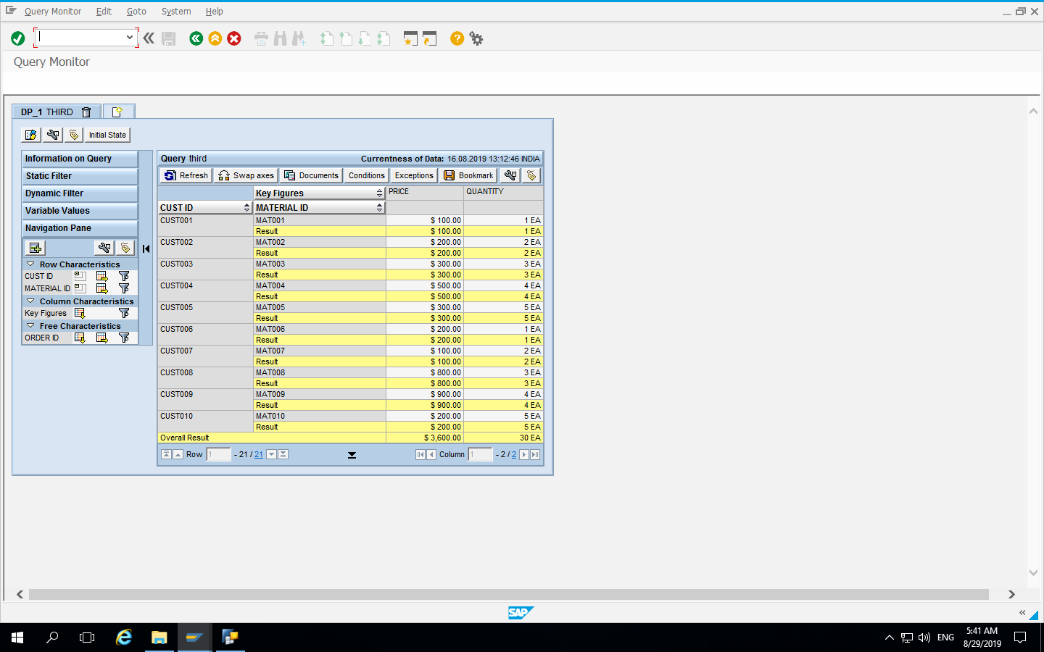
Free Characteristics :

Slide 44
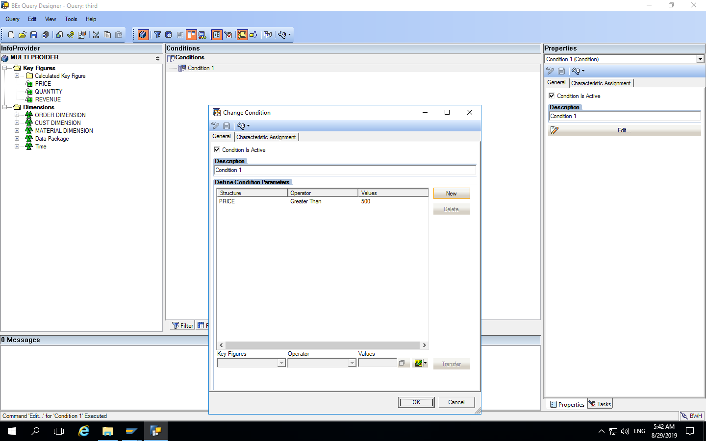
Condition :

Slide 45
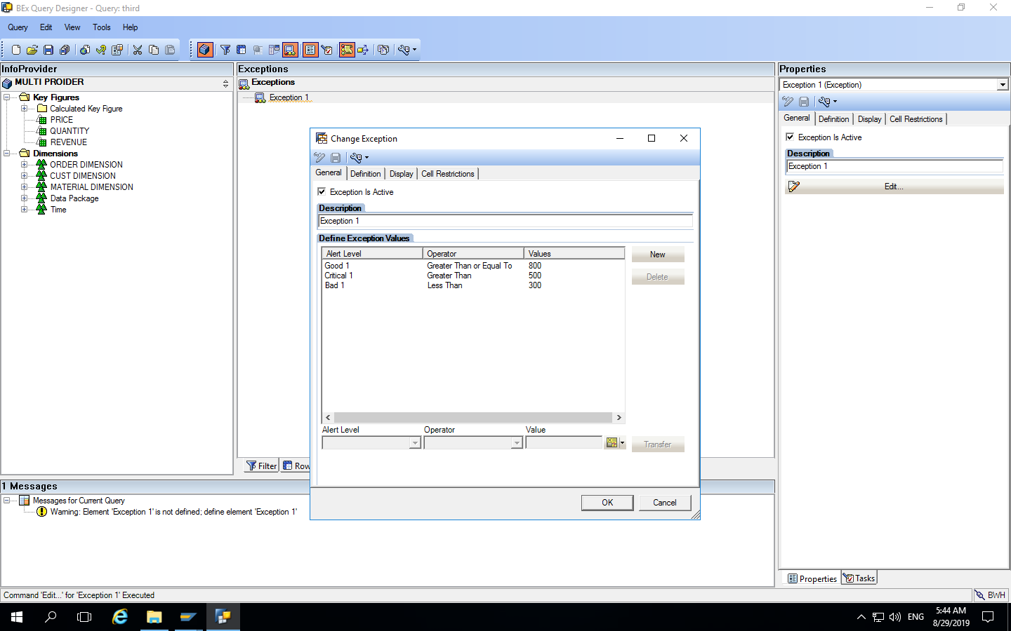
Exceptions :

Slide 46
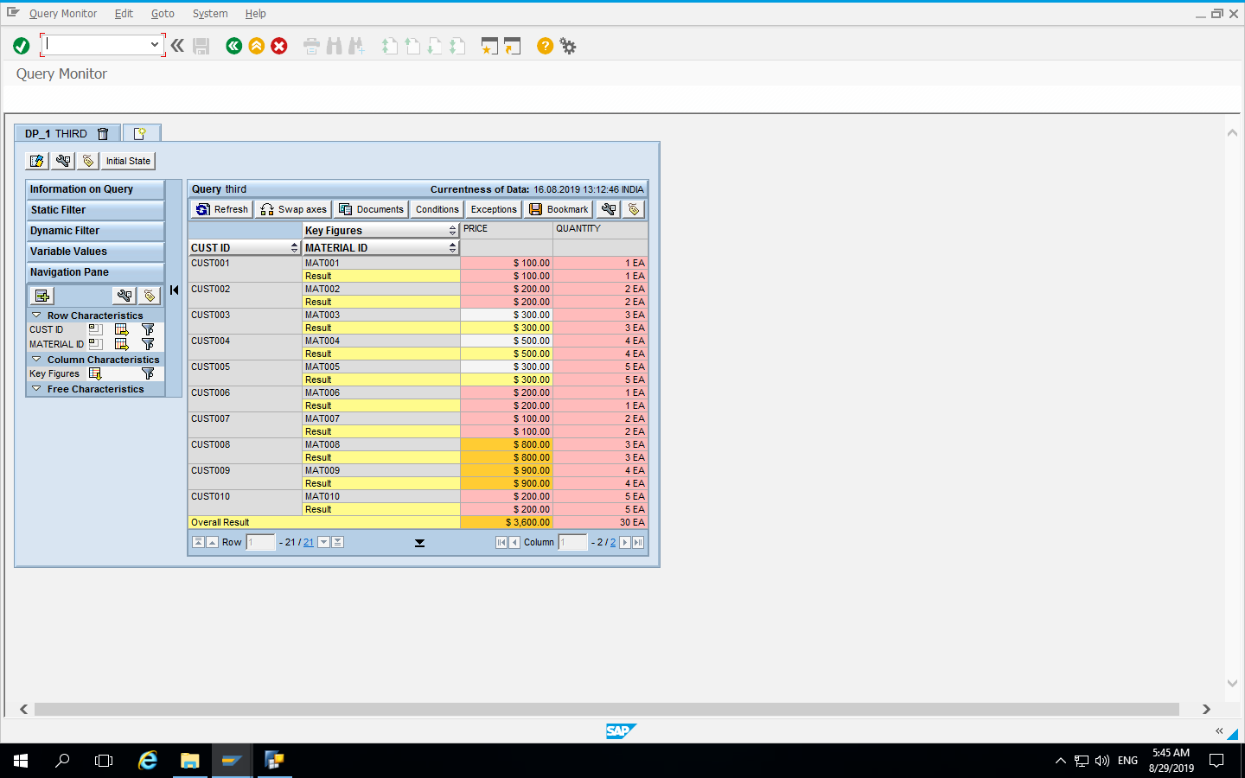

Slide 47
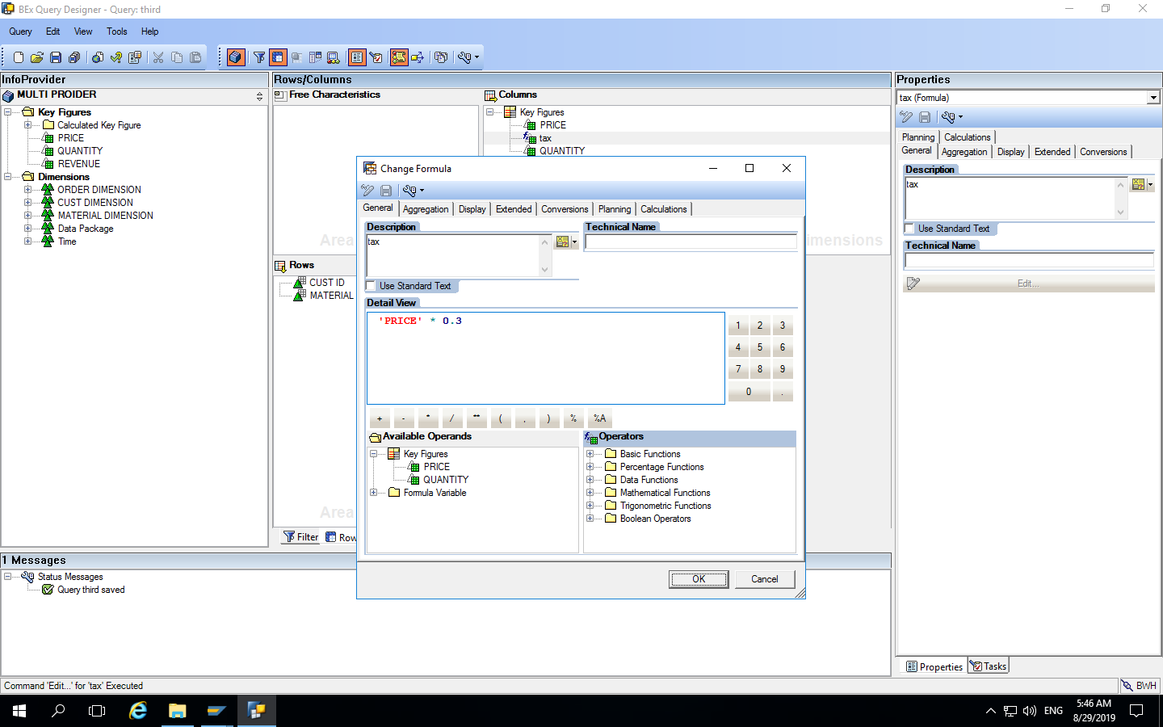
Formula :

Slide 48
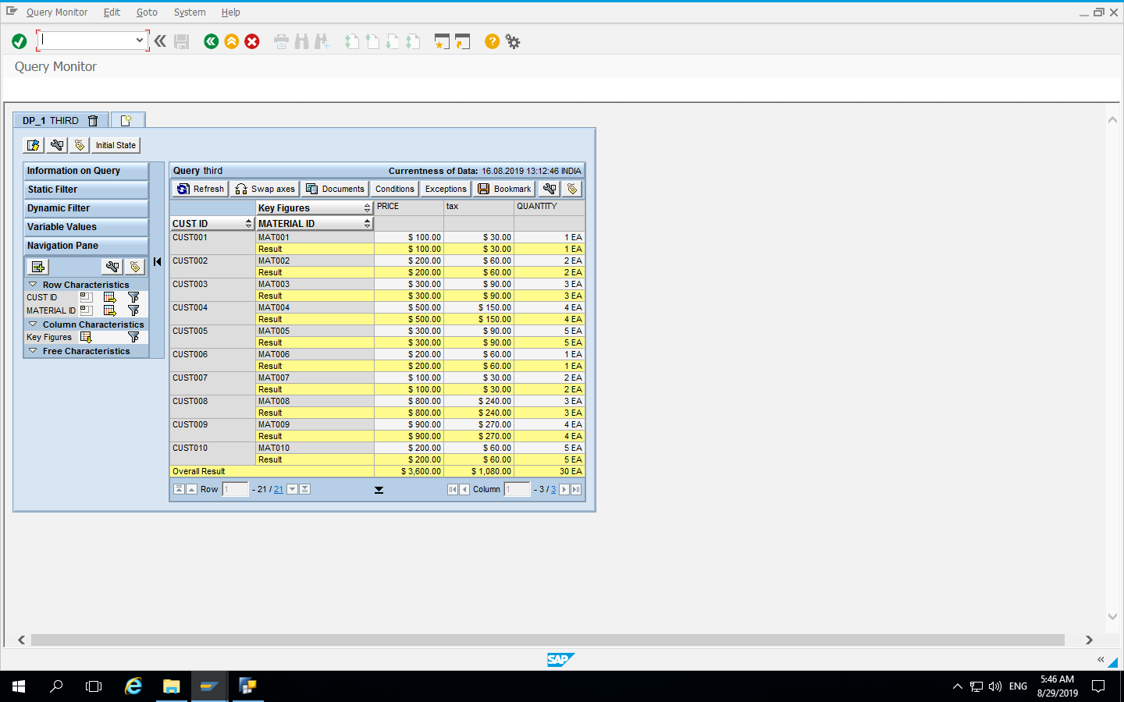

Slide 49
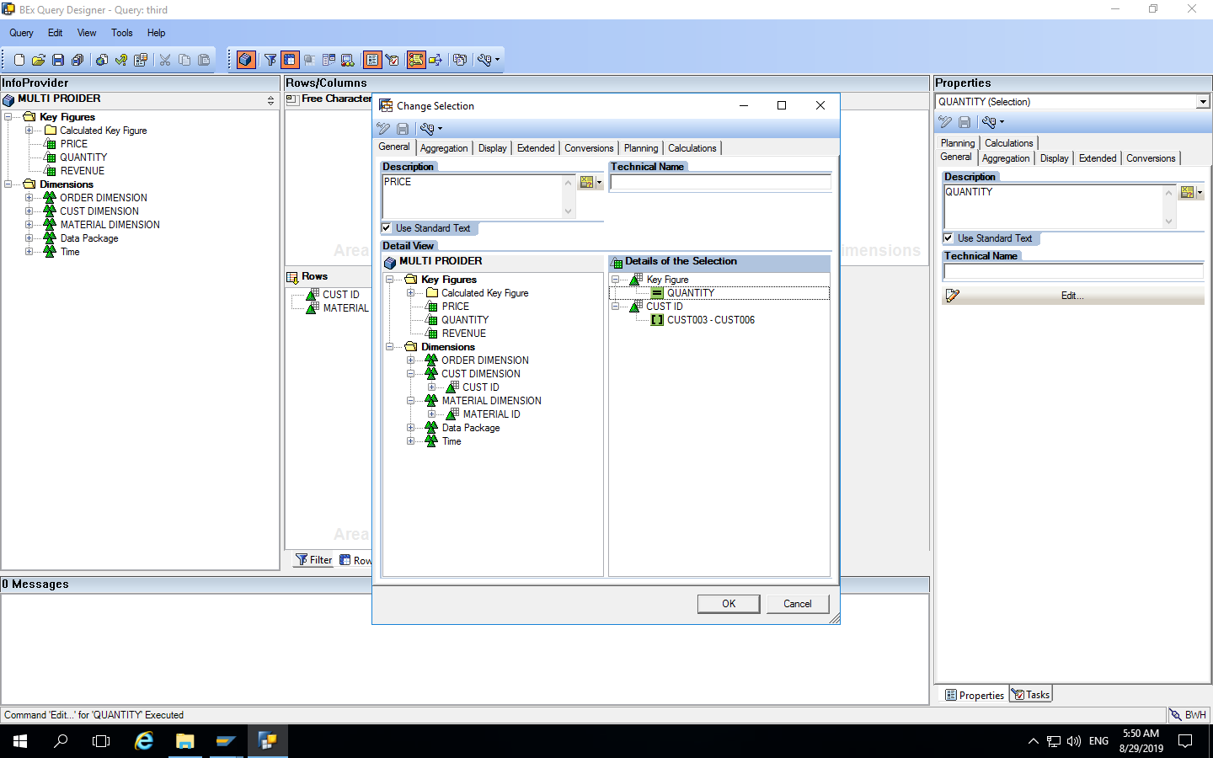
Selection :

Slide 50


Slide 51
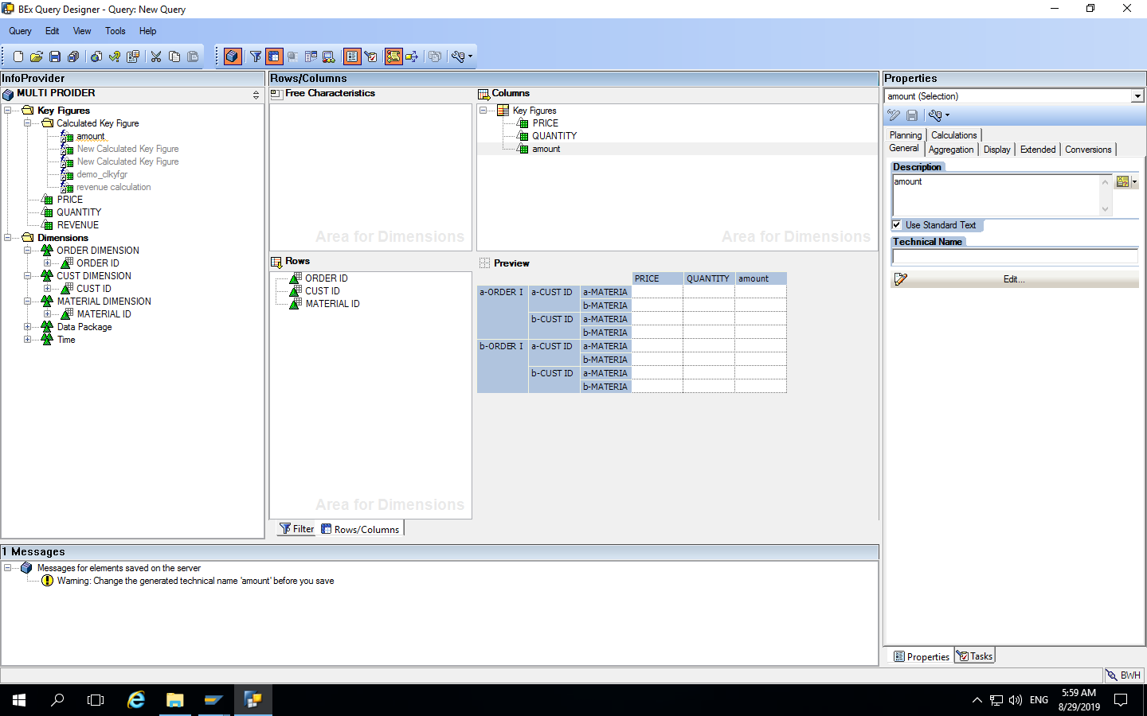
Report 3 :

Slide 52
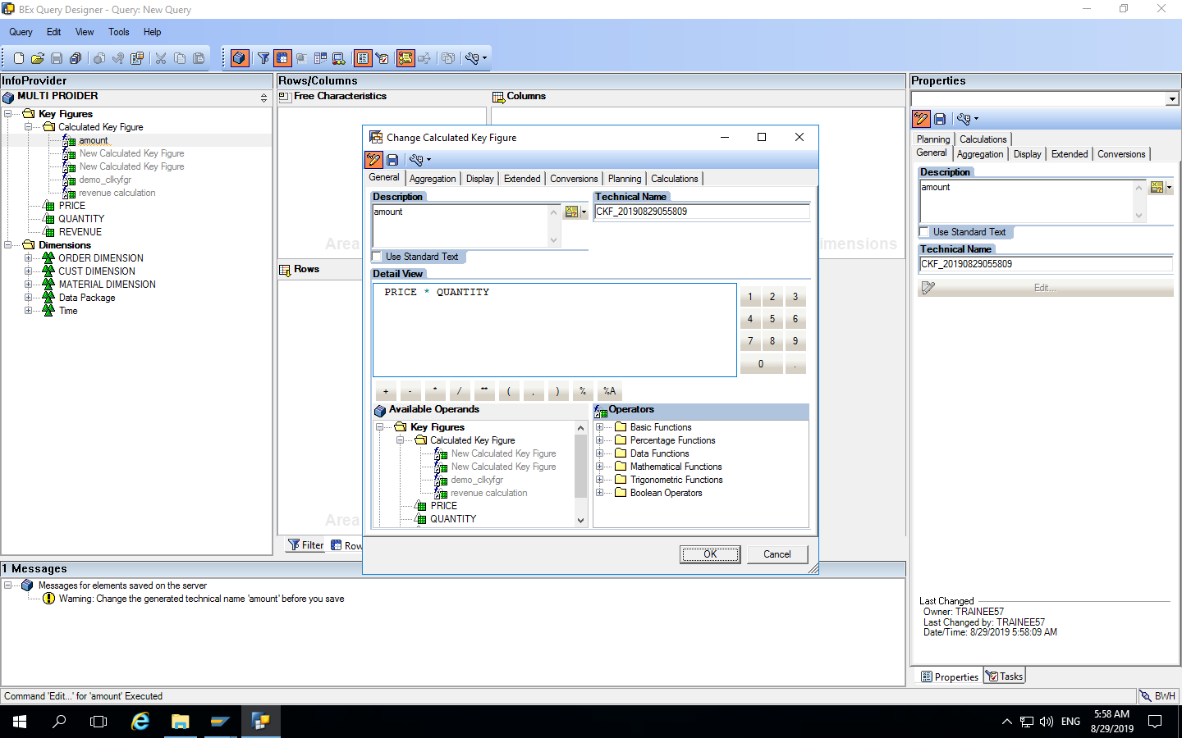
Calculated Key Figure :

Slide 53
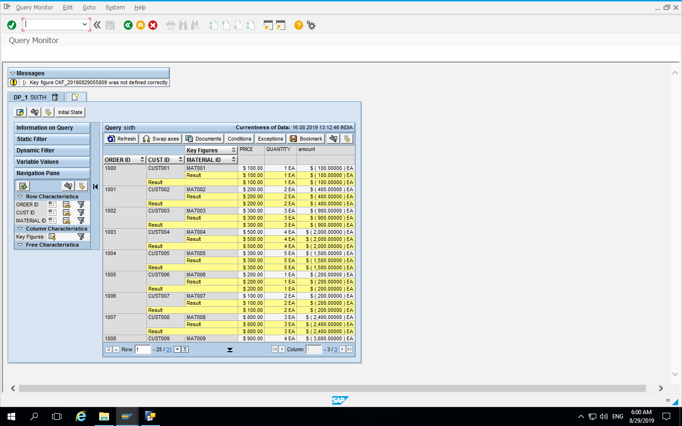

Slide 54
Conclusion :

Slide 55
Thank You

